Slide 1
Chapter 4. Models for Stationary Time Series
4.1 General Linear Processes
4.2 Moving Average Processes
4.3 Autoregressive Processes
4.4 The Mixed Autoregressive Moving Average Model
4.5 Invertibility

Slide 2
4.1 General Linear Processes
Definition
Let {Y_{t}} denote the observed time series and {e_{t}} represent an unobserved white noise series (i.e., i.i.d. random variables with zero mean). {Y_{t}} is called a general linear process if it can be represented as a linear combination of present and past white noise terms as
where

Slide 3
4.1 General Linear Processes
When ψ ’s form an exponentially decaying sequence
ψ_{j} = φ ^{j}
where –1 < φ < 1. Then

Slide 4
4.1 General Linear Processes
Theorem 4.1.1
For the time series {Y_{t}} given in Eq. (4.1.2), we have

Slide 5
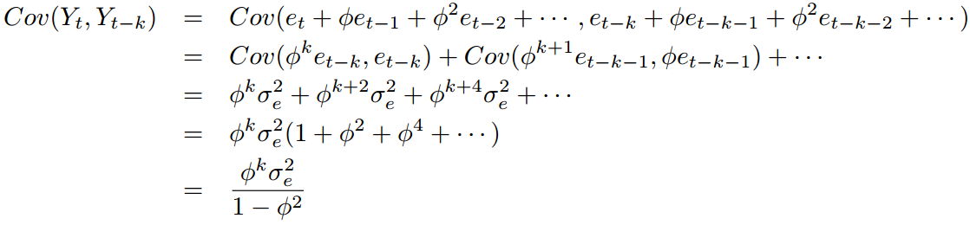
4.1 General Linear Processes
Proof
The proof of (1) and (2) are left as your own exercises.
So, (3) has been proved.

Slide 6
4.1 General Linear Processes
For (4), we consider
♦
Thus, the general linear process in Eq. (4.1.2) is stationary.

Slide 7
4.1 General Linear Processes
Theorem 4.1.1 can be generalized for the process in Eq. (4.1.1) and yields the following results
with ψ ₀ = 1.
A process with a nonzero mean μ may be obtained by adding μ to the right-hand side of Eq. (4.1.1). Since the mean does not affect the covariance properties of a process, we assume a zero mean until we begin fitting models to data.

Slide 8
4.2 Moving Average Processes
Definition
A general linear process {Y_{t}} is called a moving average process of order q (MA(q)) if

Slide 9
4.2 Moving Average Processes
The First-Order Moving Average Process (MA(1))
From Eq. (4.2.1), the MA(1) model is written as

Slide 10
4.2 Moving Average Processes
Properties of the MA(1) model:
The proofs of Properties (1) to (6) are left as the exercises.

Slide 11
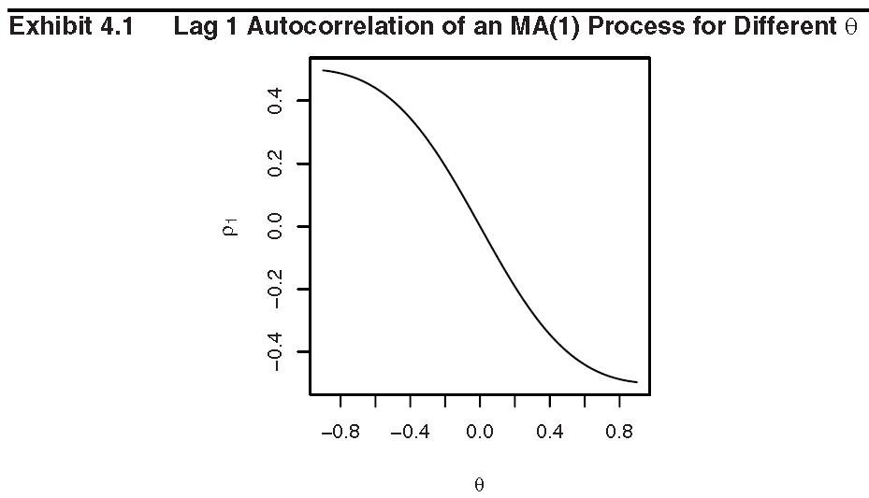
4.2 Moving Average Processes

Slide 12
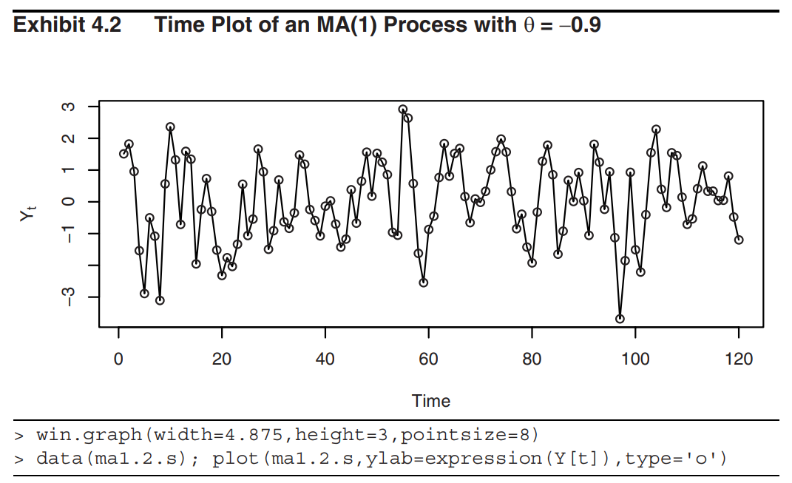
4.2 Moving Average Processes

Slide 13
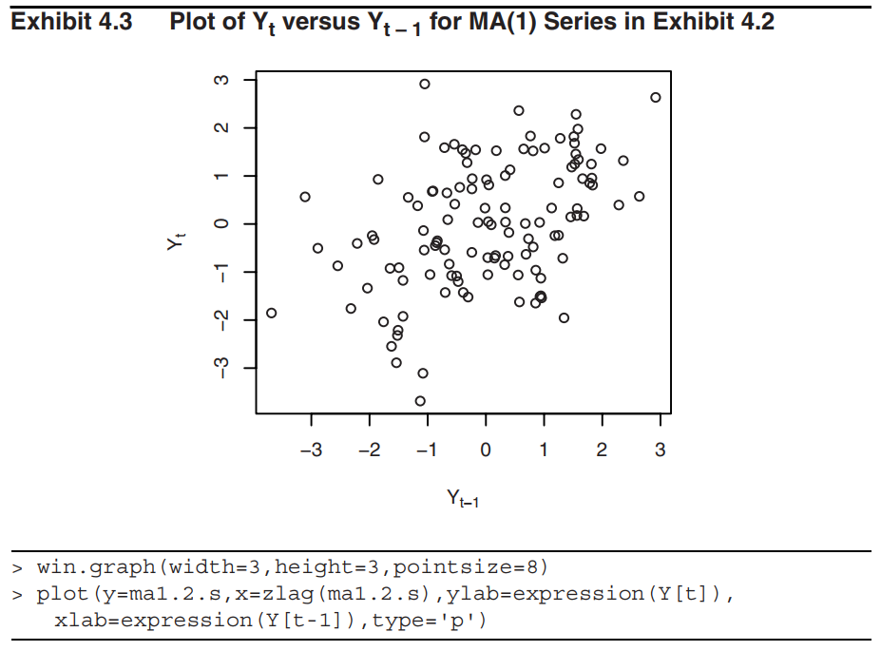
4.2 Moving Average Processes

Slide 14
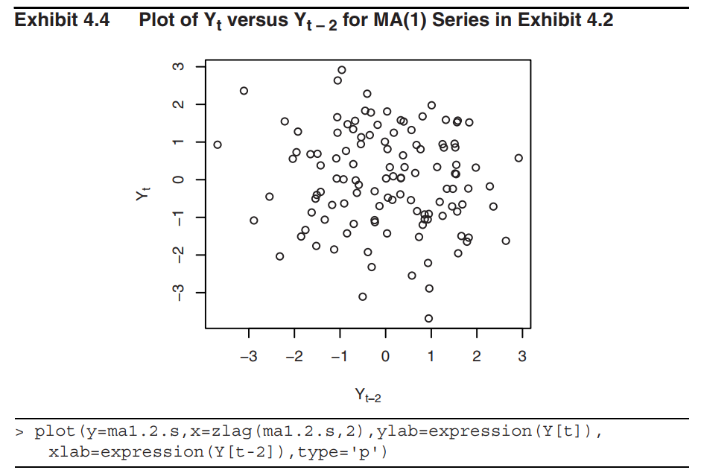
4.2 Moving Average Processes

Slide 15
4.2 Moving Average Processes
The Second-Order Moving Average Process (MA(2))
Consider the moving average process of order 2:
Similar to the MA(1) process, we have the following properties for MA(2) process

Slide 16
4.2 Moving Average Processes
Example
Let θ₁ = 1 and θ ₂ = −0.6. Then
From the properties of the MA(2) process, we have

Slide 17
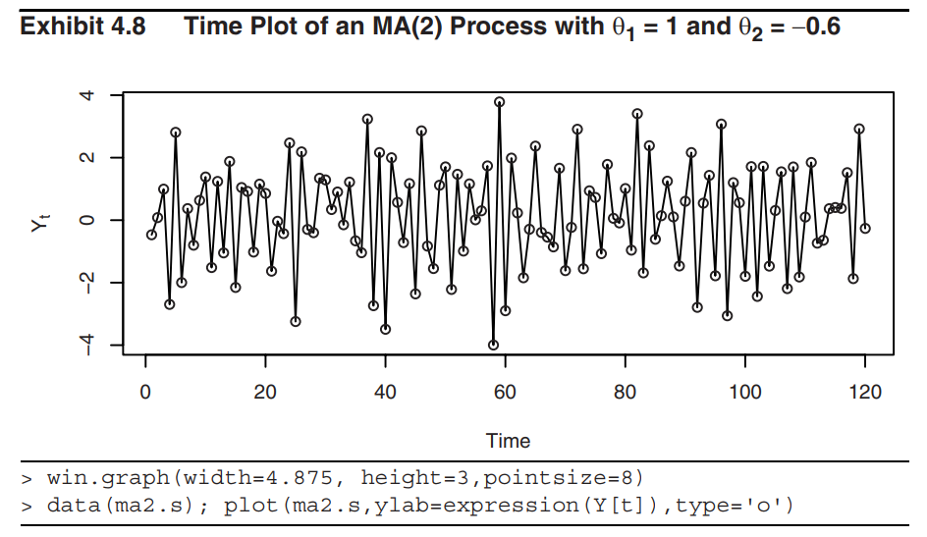
4.2 Moving Average Processes

Slide 18
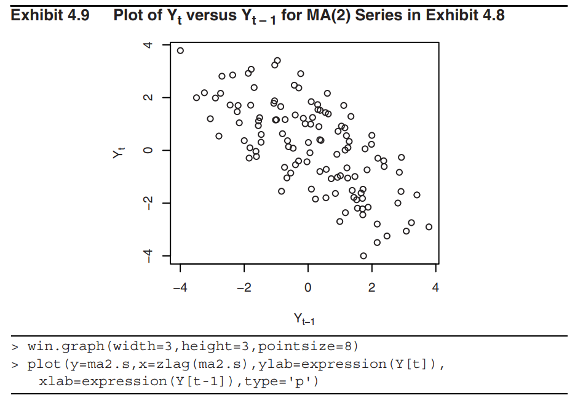
4.2 Moving Average Processes

Slide 19
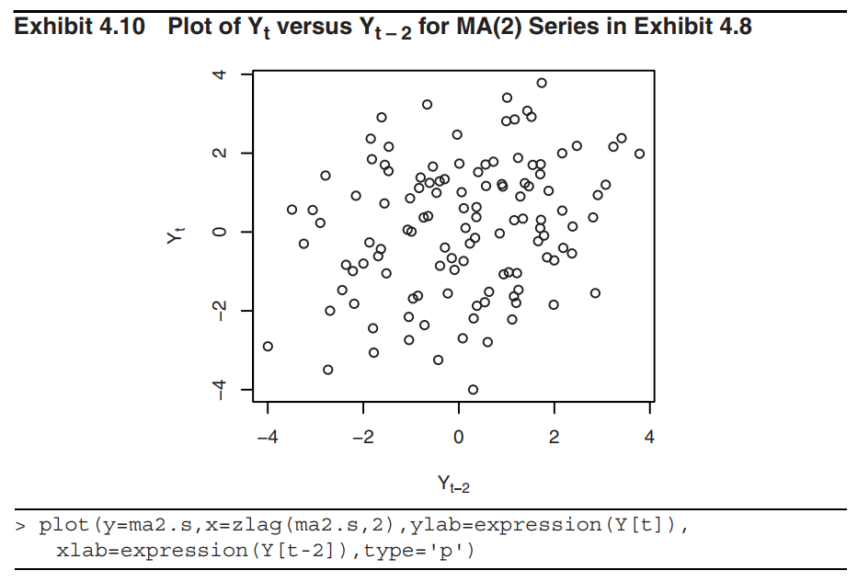
4.2 Moving Average Processes

Slide 20
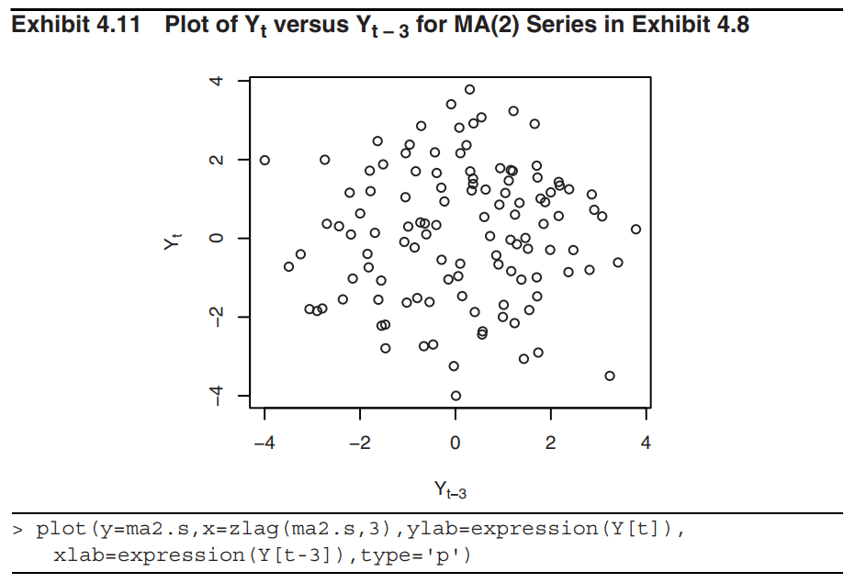
4.2 Moving Average Processes

Slide 21
4.2 Moving Average Processes
The General MA(q) process
Consider the general MA(q) process:
Similar to the MA(1) and MA(2) processes, we have

Slide 22
4.3 Autoregressive Processes
Definition
An observed time series {Y_{t}} is called a p-th order autoregressive process (AR(p)) if
In the AR(p) processes, the current value of the series Y_{t} is a linear combination of the p most recent past values of itself plus an “innovation” term e_{t} that incorporates everything new in the series at time t that is not explained by the past values.
Thus, for every t, we assume that e_{t} is independent of Y_{t–1}, Y_{t–2}, Y_{t–3},… .

Slide 23
4.3 Autoregressive Processes
The First-Order Autoregressive Process
Consider the AR(1) model
As usual, we assume that the process mean has been subtracted out so that {Y_{t}} has mean of 0.
Assume that the series {Y_{t}} is stationary.

Slide 24
4.3 Autoregressive Processes
Variance:
To make γ₀ to be well defined, we have the immediate implication that φ² < 1 or that |φ| < 1.

Slide 25
4.3 Autoregressive Processes
Autocovariance and autocorrelation functions:
For k = 1, 2, 3, …
Setting k = 1,

Slide 26
4.3 Autoregressive Processes
Use the recursive relation (4.3.4), we deduce that
and thus
Since |φ| < 1, the magnitude of the autocorrelation function decreases exponentially as the number of lags, k, increases.
If 0 < φ < 1, all correlations are positive; if –1 < φ < 0, the lag 1 autocorrelation (ρ₁) is negative and the signs of successive autocorrelations alternate from positive to negative, with their magnitudes decreasing exponentially.

Slide 27
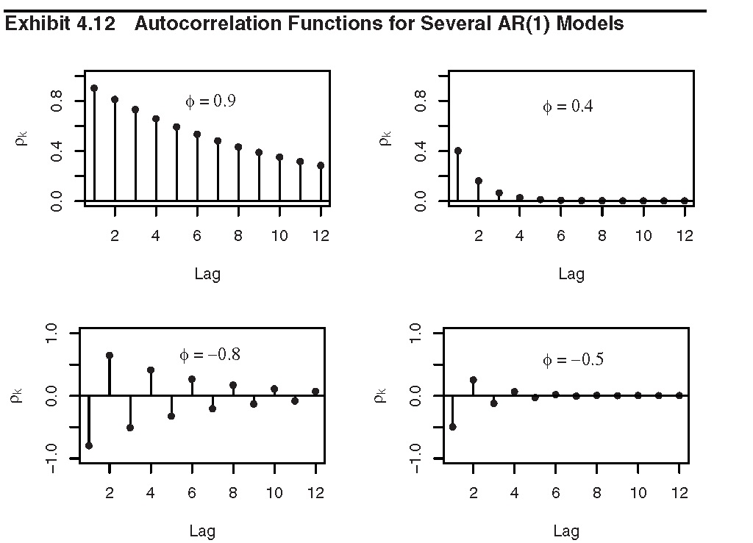
4.3 Autoregressive Processes

Slide 28
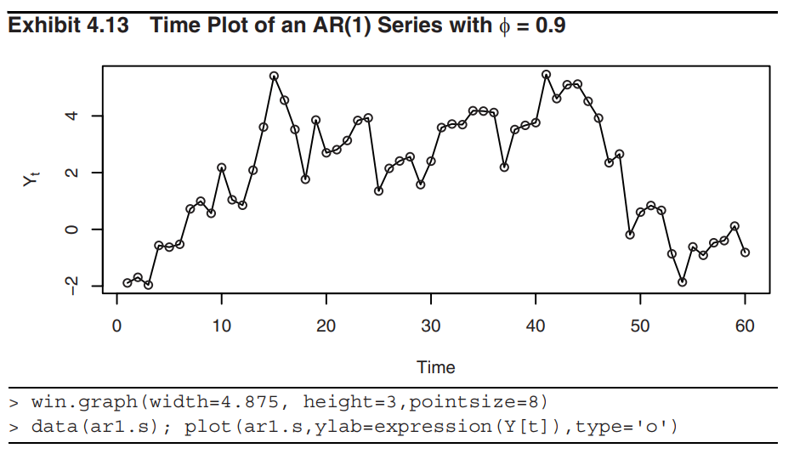
4.3 Autoregressive Processes

Slide 29
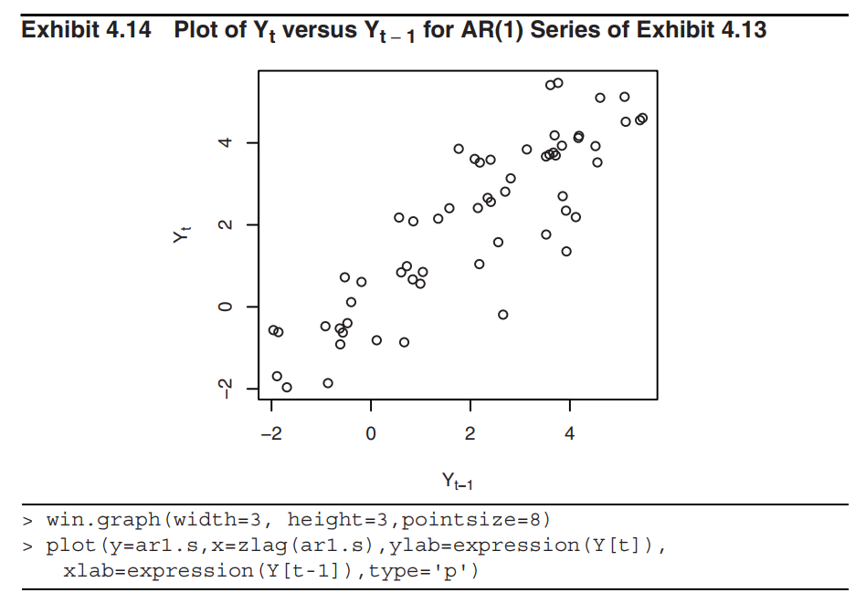
4.3 Autoregressive Processes

Slide 30
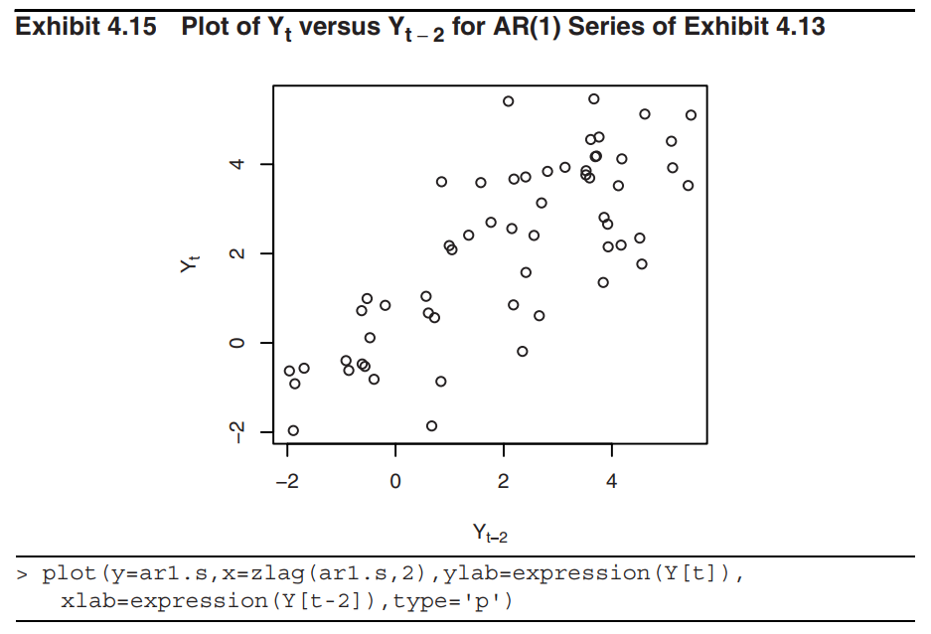
4.3 Autoregressive Processes

Slide 31
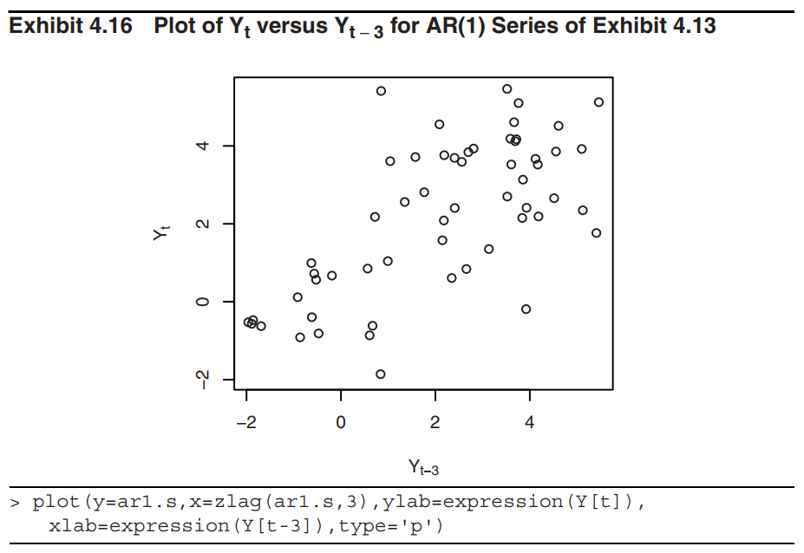
4.3 Autoregressive Processes

Slide 32
4.3 Autoregressive Processes
The General Linear Process Version of the AR(1) Model
We can express the recursive definitions (4.3.2) of AR(1) model as a general linear process as in (4.1.1).
Assuming |φ | < 1 and letting k increase without bound, it seems reasonable that we should obtain the infinite series representation

Slide 33
4.3 Autoregressive Processes
This is in the form of the general linear process of Eq. (4.1.1) with ψ_{j} = φ^{j}. Note that this representation reemphasizes the need for the restriction |φ| <1.

Slide 34
4.3 Autoregressive Processes
Stationarity of an AR(1) Process
The AR characteristic polynomial of the AR(1) process is defined by
The corresponding characteristic equation is defined by
It may be shown that, subject to the condition that e_{t} is independent of Y_{t−1}, Y_{t−2}, Y_{t−3}, …, the AR(1) process is stationary if and only if the roots of the AR characteristic equation exceed 1 in absolute value. (The proof is not required.)

Slide 35
4.3 Autoregressive Processes
In the AR(1) process, the root of the AR characteristic equation is
So, the AR(1) process is stationary if and only if

Slide 36
4.3 Autoregressive Processes
The Second-Order Autoregressive Process
Now consider the series satisfying
where, as usual, we assume that e_{t} is independent of Y_{t−1}, Y_{t−2}, Y_{t−3}, … .
The corresponding AR characteristic polynomial is
and the characteristic equation is

Slide 37
4.3 Autoregressive Processes
The roots of the characteristic equation (4.3.8) are easily found to be
Similar to the AR(1) process, subject to the condition that e_{t} is independent of Y_{t−1}, Y_{t−2}, Y_{t−3}, …, the AR(2) process is stationary if and only if the roots of the AR characteristic equation exceed 1 in absolute value (modulus).

Slide 38
4.3 Autoregressive Processes
Theorem 4.3.1
The roots of the AR characteristic equation of AR(2) process exceed 1 in absolute value if and only if all the following three conditions are satisfied (proof in Appendix):

Slide 39
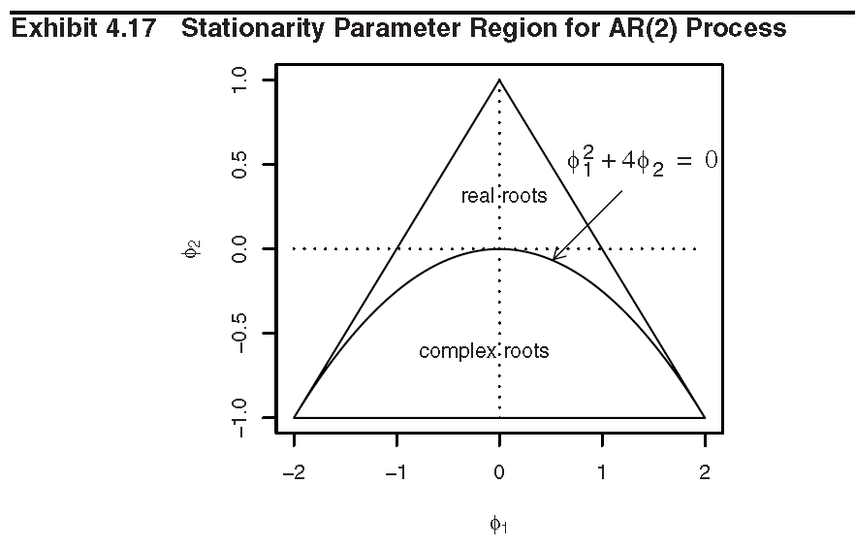
4.3 Autoregressive Processes

Slide 40
4.3 Autoregressive Processes
The Autocorrelation Function for the AR(2) process
Assuming stationarity, zero means, and that e_{t} is independent of Y_{t−k}, consider
Dividing through by γ₀,
Equations (4.3.9) and/or (4.3.10) are usually called the Yule-Walker equations.

Slide 41
4.3 Autoregressive Processes
Using the facts that ρ₀ = 1 and ρ₋₁ = ρ₁, we have
From Eq. (4.3.10), we obtain
Successive values of ρ_{k} may be easily calculated numerically from the recursive relationship (4.3.10).

Slide 42
4.3 Autoregressive Processes
The autocorrelation function can assume a wide variety of shapes.
In all cases, the magnitude of ρ_{k} dies out exponentially fast as the lag k increases.
In the case of complex roots, ρ_{k} displays a damped sine wave behavior.

Slide 43
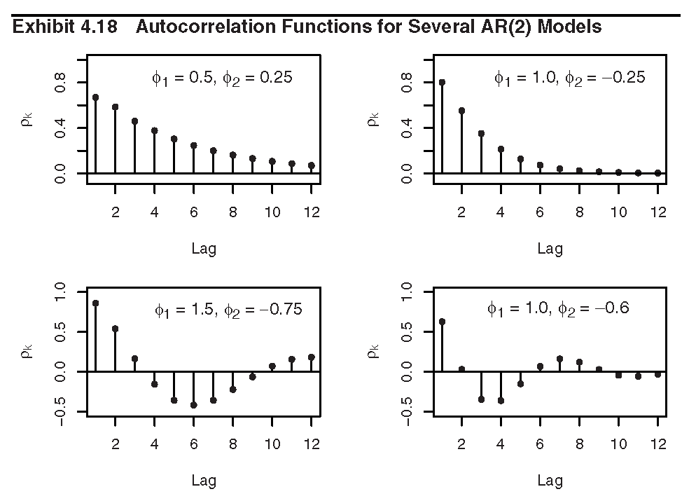
4.3 Autoregressive Processes

Slide 44
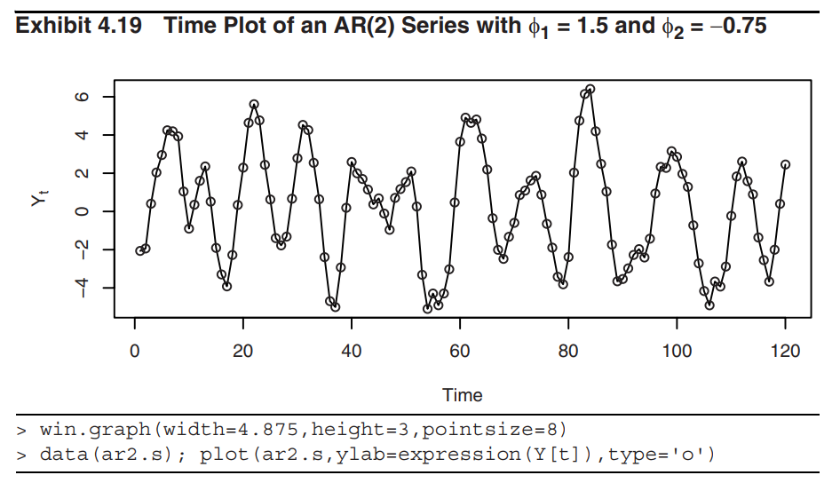
4.3 Autoregressive Processes

Slide 45
4.3 Autoregressive Processes
The Variance of the AR(2) Model
The process variance γ₀ can be expressed in terms of the model parameters φ₁, φ₂, and σ_{e}² as follows:
Setting k =1 in Eq. (4.3.9) gives a second linear equation for γ₀ and γ₁, γ₁ = φ ₁γ₀ + φ ₂γ₁, together with Eq. (4.3.14) we obtain

Slide 46
4.3 Autoregressive Processes
The ψ–Coefficients for the AR(2) Model
Substitute the general linear process representation (4.1.1) into the AR(2) model. We obtain

Slide 47
4.3 Autoregressive Processes
By equating the coefficients of e_{j}, we get the recursive relationships
These may be solved recursively to obtain
, and so on.

Slide 48
4.3 Autoregressive Processes
The General Autoregressive Process
Consider now the pth-order autoregressive model
with AR characteristic polynomial
and corresponding AR characteristic equation
Assuming e_{t} is independent of Y_{t−1}, Y_{t−2}, Y_{t−3}, …, the p-th order autoregressive process is stationary if and only if the p roots of Eq. (4.3.22) each exceed 1 in absolute value (modulus).

Slide 49
4.3 Autoregressive Processes
For the roots to be greater than 1 in modulus, it is necessary, but not sufficient, that both
Assuming stationarity and zero means, we obtain the following recursive relationship for autocorrelation

Slide 50
4.3 Autoregressive Processes
Putting k = 1, 2, …, and p into Eq. (4.3.24) and using
ρ₀ = 1 and ρ_{−k} = ρ_{k}, we get the general Yule-Walker equations
Given the numerical values for φ₁, …, φ_{p}, ρ₁, …, ρ_{p} can then be solved from Eq. (4.3.25).
We multiply Eq. (4.3.20) by Y_{t}, take expectations, and find

Slide 51
4.3 Autoregressive Processes

Slide 52
4.4 The Mixed Autoregressive Moving Average Model
Definition
An observed time series {Y_{t}} is called a mixed autoregressive moving average process of orders p and q, respectively (ARMA (p, q)) if

Slide 53
4.4 The Mixed Autoregressive Moving Average Model
The ARMA(1, 1) Model
The defining equation can be written
To derive Yule-Walker type equations, we first note that
and

Slide 54
4.4 The Mixed Autoregressive Moving Average Model
If we multiply Eq. (4.4.2) by Y_{t–k} and take expectations, we have
From Eq. (4.4.3), we obtain

Slide 55
4.4 The Mixed Autoregressive Moving Average Model
The autocorrelation function decays exponentially as the lag k increases. The damping factor is φ, but decay starts from initial value ρ₁, which also depends on the θ.
In contrast to the AR(1) model, the autocorrelation decays with damping factor φ but always from initial value ρ₀ = 1.

Slide 56
4.4 The Mixed Autoregressive Moving Average Model
The ARMA(1, 1) model can be rewritten into the general linear process as
Compare with Eq. (4.1.1),
The stationarity condition of the ARMA(1, 1) model is
|φ| < 1, or equivalently the root of the AR characteristic equation 1 – φx = 0 must exceed the unity in absolute value.

Slide 57
4.4 The Mixed Autoregressive Moving Average Model
For the general ARMA(p, q) model, we state the following facts without proof:
Assume that e_{t} is independent of Y_{t−1}, Y_{t−2}, Y_{t−3}, … .
The ARMA(p, q) model is stationary if and only if all the roots of the AR characteristic equation φ(x) = 0 exceed unity in modulus.

Slide 58
4.4 The Mixed Autoregressive Moving Average Model
If the stationarity conditions are satisfied, then the ARMA(p, q) model can be expressed as a general linear process with ψ-coefficients determined from
where we take ψ_{j} = 0 for j < 0 and θ_{j} = 0 for j > q.

Slide 59
4.4 The Mixed Autoregressive Moving Average Model
Assuming stationarity and for k > q,
Similar equations can be developed for k = 1, 2, 3, …, q that involve θ₁, θ₂, …, θ_{q}.

Slide 60
4.5 Invertibility
Question: Can a moving average model be reexpressed as an autoregression?
Consider an MA(1) model

Slide 61
4.5 Invertibility
If |θ | < 1, we may continue this substitution “infinitely” into the past and obtain
If |θ | < 1, the MA(1) model can be inverted into an infinite-order autoregressive model. We say that the MA(1) model is invertible if and only if |θ | < 1.

Slide 62
4.5 Invertibility
Definition
For a general MA(q) or ARMA(p, q) model, the MA characteristics polynomial is defined as
and the corresponding MA characteristic equation

Slide 63
4.5 Invertibility
It can be shown that the MA(q) model is invertible; that is, there are coefficients π_{j} such that
if and only if the roots of the MA characteristic equation exceed 1 in modulus.

Slide 64
4.5 Invertibility
It may also be shown that there is only one set of parameter values that yield an invertible MA process with a given autocorrelation function. For example, consider
Both (A) and (B) have the same autocorrelation function, but only (B) with the root −2 in the corresponding MA characteristic equation is invertible.
From now on, we will restrict our attention to the physically sensible class of invertible models.

Slide 65

Summary
General linear process
  Mean, variance, autocovariance, and autocorrelation functions.

Slide 66

Summary
Moving average process
  MA(q):
  Mean, variance, autocovariance, and autocorrelation functions.
  Stationary?
  ACF cuts off at lag q

Slide 67


Summary
Autoregressive process
  AR(p):
  Mean, variance, autocovariance, and autocorrelation functions under the assumption of stationarity.
  Stationarity condition
    p roots of AR characteristic equation all exceed 1 in absolute value (modulus)
    What are the stationarity conditions for AR(1) and AR(2)?
  For stationary AR processes, ACF dies off exponentially (real roots) or in a damped sine wave pattern (complex roots)

Slide 68
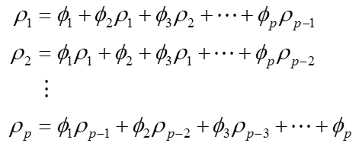
Summary
Autoregressive process (cont’d)
  Yule-Walker equations

Slide 69
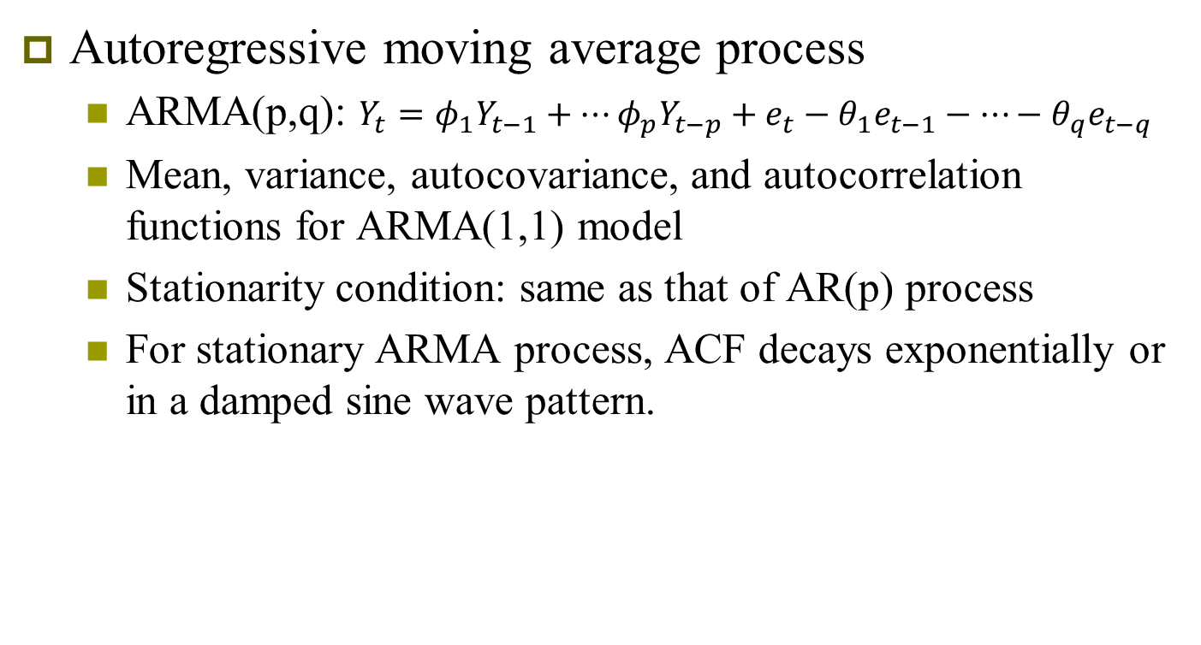
Summary
Autoregressive moving average process
  ARMA(p,q): $Y_{t}=φ_{1}Y_{t−1}+…φ_{p}Y_{t−p}+e_{t}−θ_{1}e_{t−1}−…−θ_{q}e_{t−q}$
  Mean, variance, autocovariance, and autocorrelation functions for ARMA(1,1) model
  Stationarity condition: same as that of AR(p) process
  For stationary ARMA process, ACF decays exponentially or in a damped sine wave pattern.

Slide 70

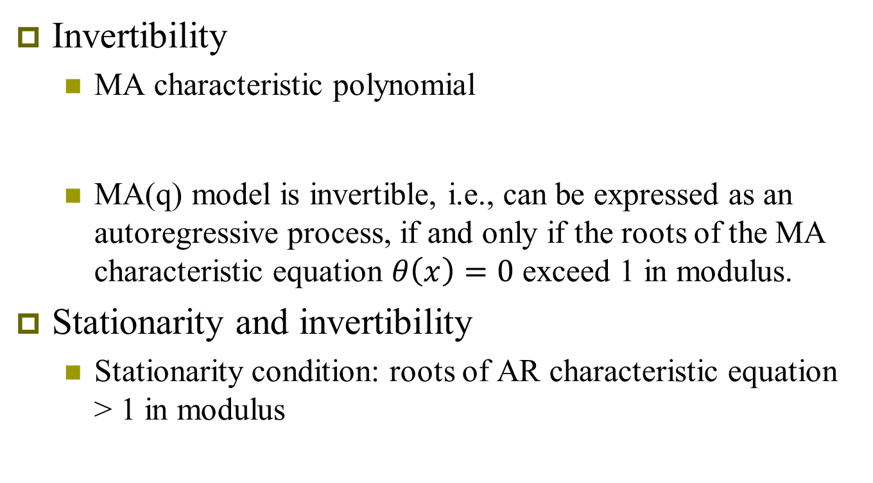
Summary
Invertibility
  MA characteristic polynomial
  MA(q) model is invertible, i.e., can be expressed as an autoregressive process, if and only if the roots of the MA characteristic equation $θ\left(x\right)=0$ exceed 1 in modulus.
Stationarity and invertibility
  Stationarity condition: roots of AR characteristic equation > 1 in modulus

Slide 71
Summary
Stationarity and invertibility
  Stationarity condition: roots of AR characteristic equation > 1 in modulus
    If an AR or ARMA model is stationary, it can be re-expressed as an MA(∞) process
  Invertibility condition: roots of MA characteristic equation > 1 in modulus
    If an MA or ARMA model is invertible, it can be re-expressed as an AR(∞) process

